Slide 1
Facial Recognition System for Door Lock
By Shijie An, Xianxin Deng, KwanYi May

Slide 2
Structure of system
Database
API
Raspberry Pi
Camera
local

Slide 3
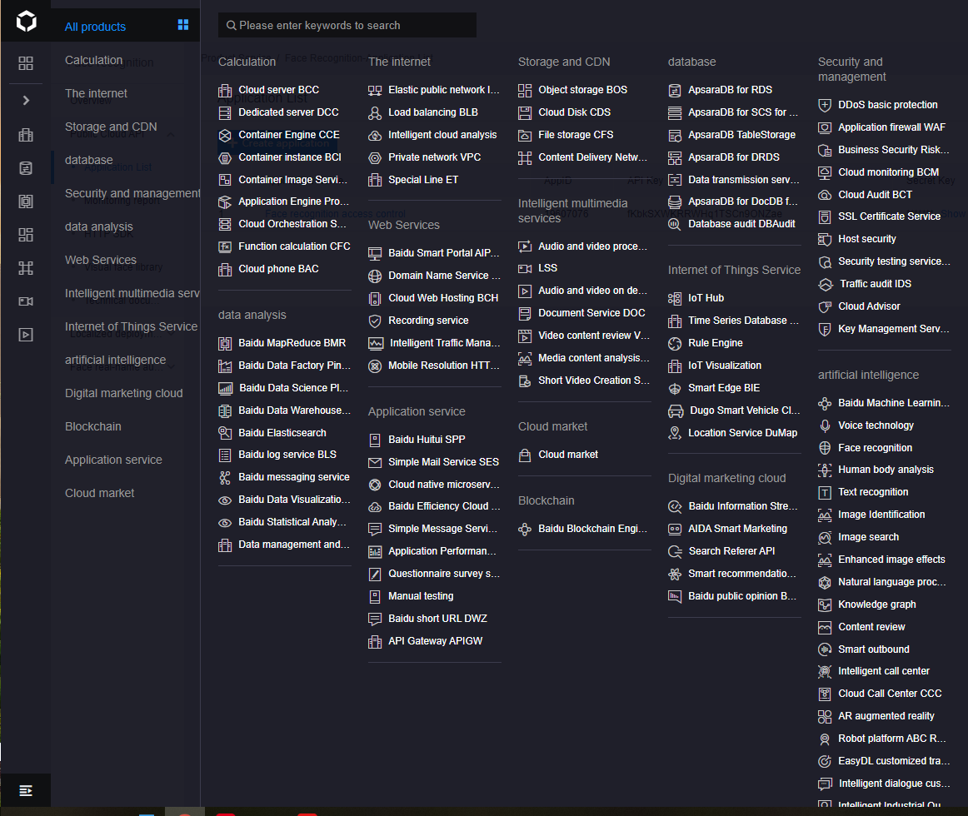
Baidu Cloud Database
Contains many artificial intelligence product.

Slide 4
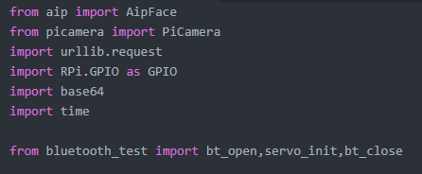
Import
API import
Pi import
Database imports

Slide 5
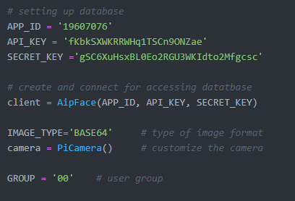
Setting Up Database
Using an existing database
Apply an account for accessing the database
Creates connection between local and the remoted database
Pre-setting image format
Connects with raspberry pi

Slide 6
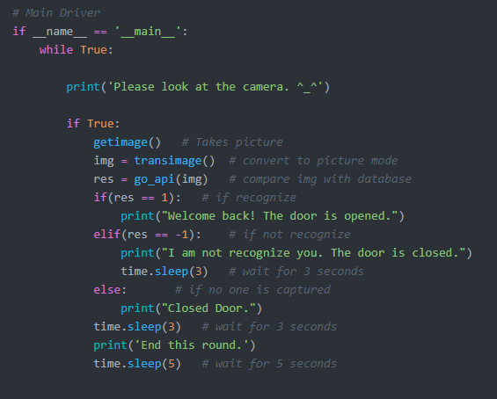
Main Driver
Methods/Functions in main driver:
getimage()
transimage()
go_api(arg)

Slide 7
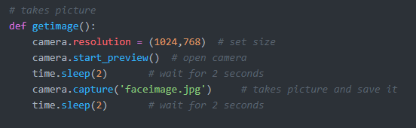
Getimage()
Pre-set the picture size
Having 2 seconds to adjust your face
Save token picture to database

Slide 8
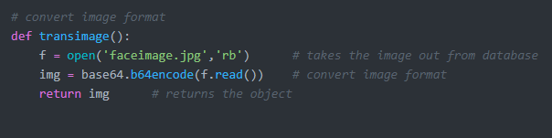
Transimage()
Takes out image from database
Convert image format into comparable format

Slide 9
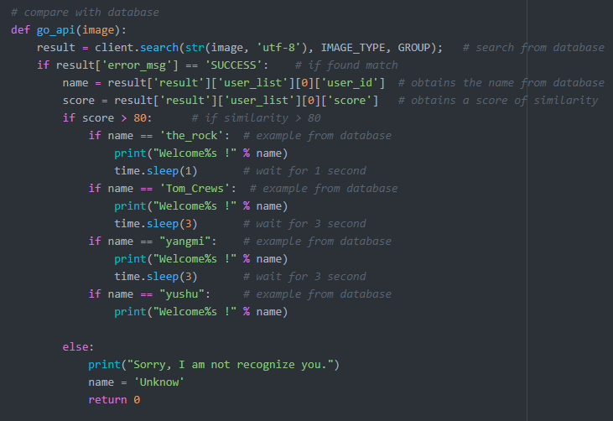
Go_api(arg)
Compares token image with database
Gets a score of similarity
Depending on the score and matched result, the output is vary.

Slide 10
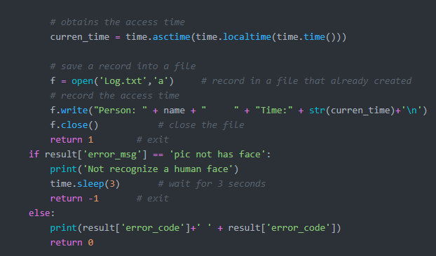
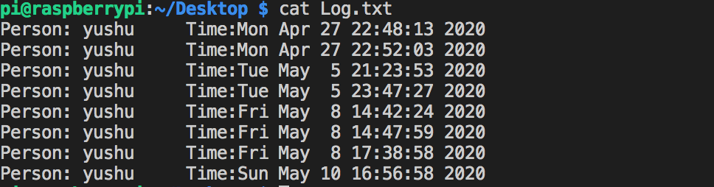
Go_api(arg) cont.
Obtains the access time
Record the person’s name and access time in a file
Output an error message if there’s no human face was captured

Slide 11
Demo

Slide 12
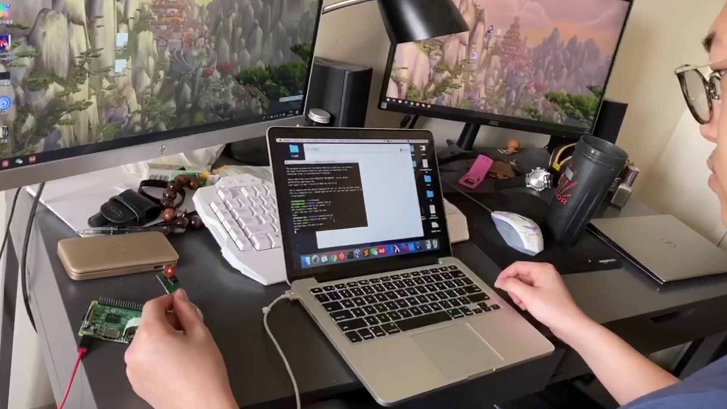

Slide 13
Security for user
User need to confirm and upload their own picture(or others) to database.
Can picture of user open the door?
Yes

Slide 14
Question?

